Slide 1

Introduction to
Linear Algebra
Eslam Ahmed
Software Engineer

Slide 2

Vectors

Slide 3




Vectors in Machine Learning
400
350
 |  | Feature Vector
300
250
200
150
100
50
 | 1 |  | 2 | 3 |  | 4 | 5 | 6 | 7 | 8 | 9 | 10
Rating | Area sq. mtr
5 | 200
7 | 300
5 | 325
8 | 250
6 | 300
7 | 350
7.5 | 250
9 | 350
Area
Ratings

Slide 4

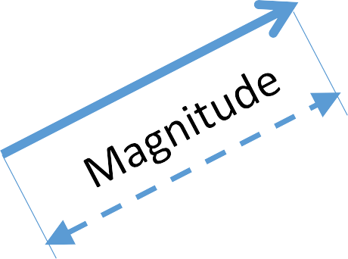
What is a vector?
V

Slide 5
[ ]
What is a vector?
Cartesian:
 |  |  |  | 4
 |  |  |  | 3
 |  |  |  | 2
 |  |  |  | 1 |  | 𝜃
 |  |  |  | 0 | 1 | 2 | 3 | 4 | 5
V =
3
2
Polar:
V = (r, 𝜃)

Slide 6

Unit Vector
^
a

Slide 7
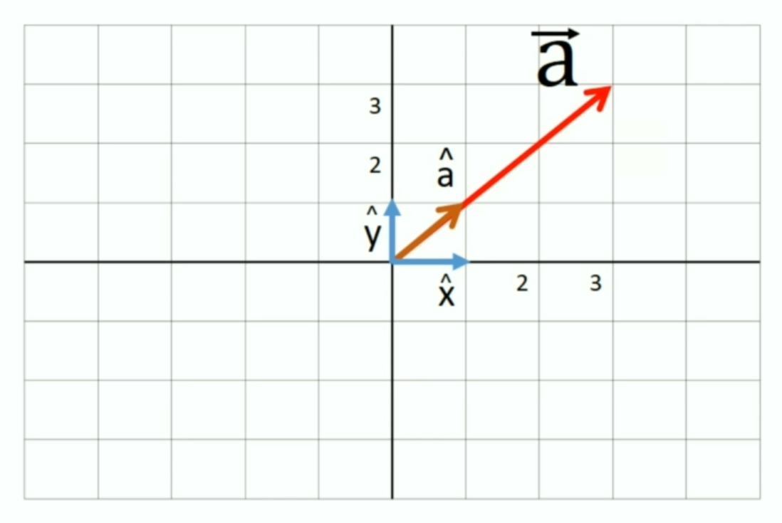
Unit Vector
a = 3 * a
a = 3*x + 3*y
^
^
^

Slide 8
Vector Arithmetic
Addition
Subtraction
Multiplication

Slide 9
[ ]
Vector Addition
V1 =
3
2
 |  |  |  | 4
 |  |  |  | 3
 |  |  |  | 2
 |  |  |  | 1
 |  |  |  | 0 | 1 | 2 | 3 | 4 | 5
 |  |  |  | -1
 |  |  |  | -2
 |  |  |  | -3

Slide 10
[ ]
[ ]
Vector Addition
V1 =
V2 =
3
2
 |  |  |  | 4
 |  |  |  | 3
 |  |  |  | 2
 |  |  |  | 1
 |  |  |  | 0 | 1 | 2 | 3 | 4 | 5
 |  |  |  | -1
 |  |  |  | -2
 |  |  |  | -3
1
-1

Slide 11

[ ]
[ ]
Vector Addition
V1 =
V2 =
3
2
 |  |  |  | 4
 |  |  |  | 3
 |  |  |  | 2
 |  |  |  | 1
 |  |  |  | 0 | 1 | 2 | 3 | 4 | 5
 |  |  |  | -1
 |  |  |  | -2
 |  |  |  | -3
1
-1
V1 + V2

Slide 12

[ ]
[ ]
Vector Addition
V1 =
V2 =
3
2
 |  |  |  | 4
 |  |  |  | 3
 |  |  |  | 2
 |  |  |  | 1
 |  |  |  | 0 | 1 | 2 | 3 | 4 | 5
 |  |  |  | -1
 |  |  |  | -2
 |  |  |  | -3
1
-1
V1 + V2

Slide 13

[ ]
[ ]
Vector Addition
V1 =
V2 =
3
2
 |  |  |  | 4
 |  |  |  | 3
 |  |  |  | 2
 |  |  |  | 1
 |  |  |  | 0 | 1 | 2 | 3 | 4 | 5
 |  |  |  | -1
 |  |  |  | -2
 |  |  |  | -3
1
-1
V1 + V2

Slide 14
[ ]
[ ]
Vector Addition
V1 =
V2 =
3
2
 |  |  |  | 4
 |  |  |  | 3
 |  |  |  | 2
 |  |  |  | 1
 |  |  |  | 0 | 1 | 2 | 3 | 4 | 5
 |  |  |  | -1
 |  |  |  | -2
 |  |  |  | -3
1
-1
[ ]
4
1
V1 + V2 =

Slide 15


V1 =
V2 =
Vector Subtraction
[ ]
[ ]
[ ]
3
2
 |  |  |  | 4
 |  |  |  | 3
 |  |  |  | 2
 |  |  |  | 1
 |  |  |  | 0 | 1 | 2 | 3 | 4 | 5
 |  |  |  | -1
 |  |  |  | -2
 |  |  |  | -3
1
-1
2
3
V1 V2 =

Slide 16
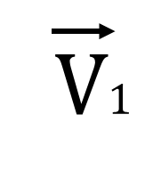
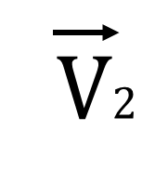
Vector Multiplication (Cross Product)
_{* n}^
Unit vector
V1 * V2 = V1
* V2
sin(𝜃)
Magnitude
𝜃

Slide 17

Matrices

Slide 18
Rows
What is a Matrix?
2 3 4
1 6 7
Columns
X =

Slide 19
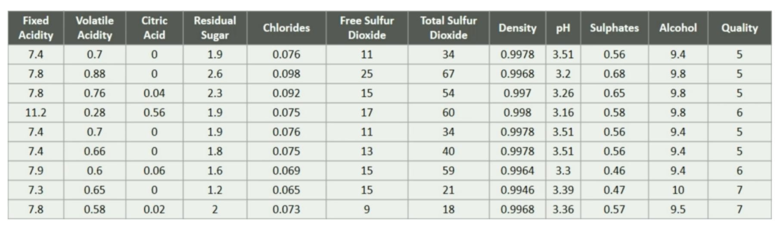
What is a Matrix?
Datasets treated as Matrix that have many rows, each row represents a feature vector.

Slide 20
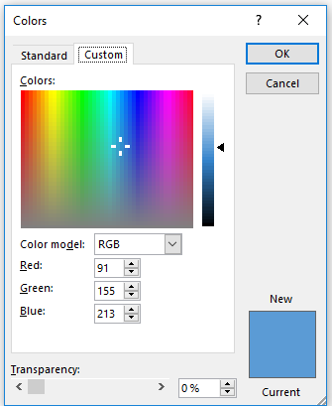

Why should we learn Matrices?
Matrix of Pixels
R G B
230
169
43

Slide 21
Matrix Arithmetic
Addition
Subtraction
Multiplication

Slide 22
Matrix Addition
2 3 4
1 6 7
1 8 -1
5 -2 -3
X =
Y =
2 + 1 3 + 8
1 + 5 6 + (-2)
4 + (-1)
7 + (-3)
3 11 3
6 4 4
X + Y =
=

Slide 23
Matrix Subtraction
2 3 4
1 6 7
1 8 -1
5 -2 -3
X =
Y =
2 - 1 3 - 8
1 - 5 6 - (-2)
4 - (-1)
7 – (-3)
1 -5 5
-4 8 10
X - Y =
=

Slide 24
Matrix Multiplication – Scalar
2 3 4
1 6 7
X =
2 3 4
1 6 7
4 6 8
2 12 14
2 * X = 2 *

Slide 25
Matrix Multiplication – Dot product
2 3 4
1 6 7
2 3
1 6
2 3
- -
X =
A =
X . A =
- -
2 X 2
2 X
3 3
X 2

Slide 26
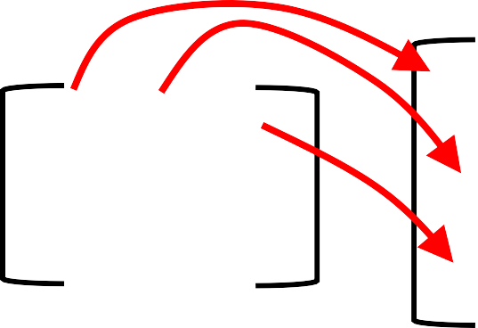
Matrix Multiplication – Dot product
2 3 4
1 6 7
2 3
1 6
2 3
X =
A =
2 3
1 6
2 3
X . A = 2 3 4
1 6 7

Slide 27
Matrix Multiplication – Dot product
2 3 4
1 6 7
2 3
1 6
2 3
X =
A =
2 3
1 6
2 3
X . A =
2 3 4
1 6 7

Slide 28
Matrix Multiplication – Dot product
2 3 4
1 6 7
2 3
1 6
2 3
X =
A =
2 3
1 6
2 3
15
X . A =
2 3 4
1 6 7
(2*2) + (3*1) + (4*2) = 15

Slide 29
Matrix Multiplication – Dot product
2 3 4
1 6 7
2 3
1 6
2 3
X =
A =
2 3
1 6
2 3
15 36
X . A =
2 3 4
1 6 7
(2*3) + (3*6) + (4*3) = 36

Slide 30
Matrix Multiplication – Dot product
2 3 4
1 6 7
2 3
1 6
2 3
X =
A =
2 3
1 6
2 3
15 36
X . A =
2 3 4
1 6 7
22
(1*2) + (6*1) + (7*2) = 22

Slide 31
Matrix Multiplication – Dot product
2 3 4
1 6 7
2 3
1 6
2 3
X =
A =
2 3
1 6
2 3
15 36
X . A =
2 3 4
1 6 7
22 60
(1*3) + (6*6) + (7*3) = 60

Slide 32
Matrix Multiplication – Dot product
2 3 4
1 6 7
2 3
1 6
2 3
15 36
X =
A =
X . A =
22 60
2 X 2
2 X
3 3
X 2

Slide 33
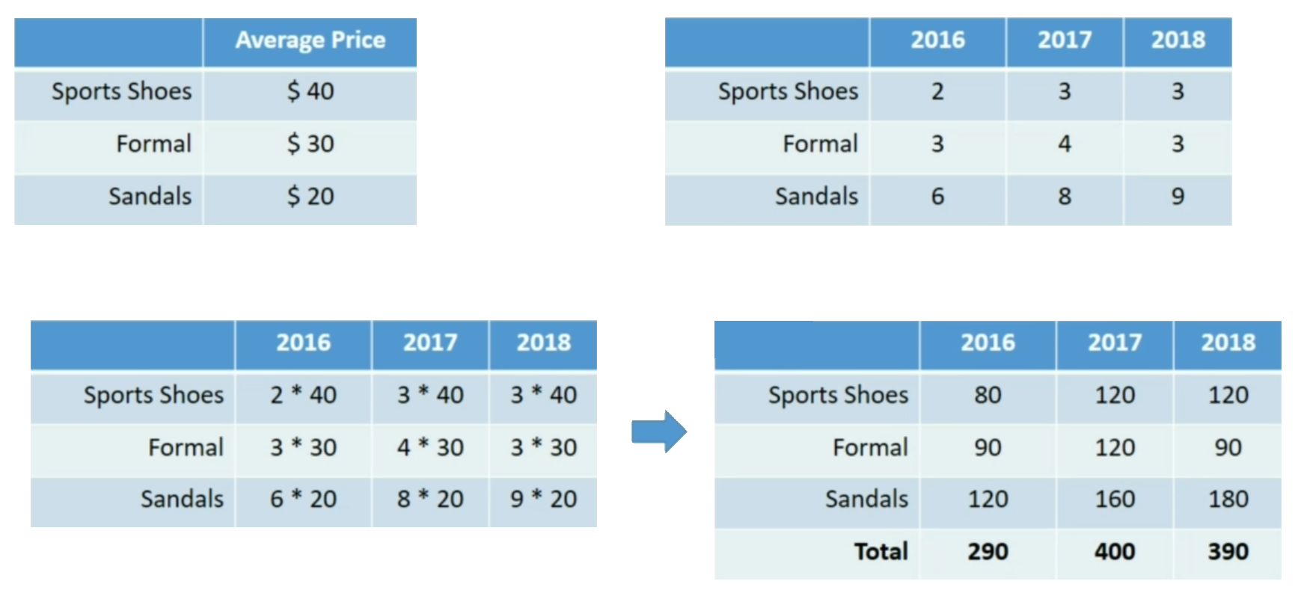
Matrix Multiplication – Example

Slide 34
Matrix Division
3 4 -1
7 -3 2
2 3 4
1 6 7
A =
X =
A
-1
= A . X
X
We will see soon how to get the inverse of a Matrix

Slide 35

Important Matrix Terms

Slide 36
Matrix Terms
Determinant of the Matrix
Inverse of Matrix
Identity Matrix
Transpose of the Matrix

Slide 37
Determinant = ad - bc
Determinant of a Matrix
a b
c d

Slide 38
Inverse of a Matrix
a b
c d
-1
1/A = Inverse of A = A
A =
d -b
-1
A =
1
ad - bc
-c a

Slide 39
Identity Matrix
1 0 0
I = | 0 | 1 | 0
 | 0 | 0 | 1

Slide 40
Identity Matrix
1 0 0
2 3 4
I = | 0 | 1 | 0 | A = | 1 | 6 | 1
 | 0 | 0 | 1 |  | 2 | 3 | 8
A * I = A

Slide 41
Transpose of a matrix
2 1
3 6
4 7
2 3 4
1 6 7
T
X =
X =

Slide 42
Transpose of a matrix
2 1
3 6
4 7
2 3 4
1 6 7
T
X =
X =

Slide 43

Vector Transformation using Matrix

Slide 44
Vector Transformation
1 -1
1 2
2 x 2
V =
3
2
 |  |  |  | 4
 |  |  |  | 3 |  |  | V
 |  |  |  | 2
 |  |  |  | 1
 |  |  |  | 0 | 1 | 2 | 3 | 4 | 5
T =
2 x 1
T . V =
(1*3) + (-1*2)
(1*3) + (2*2)
=
3 - 2
3 + 4

Slide 45
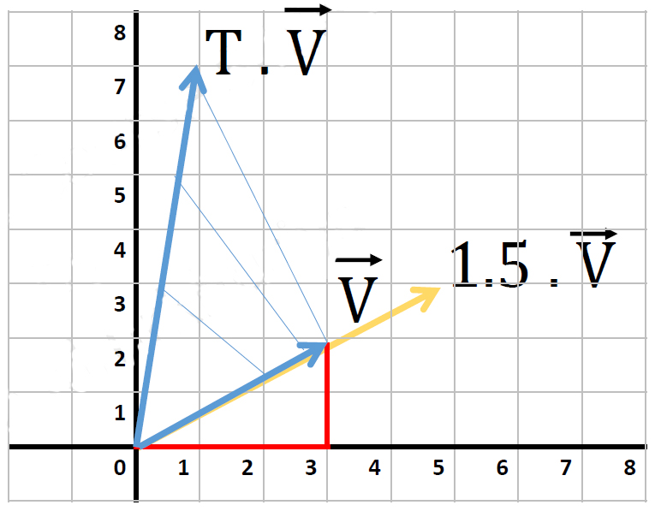
Vector Transformation
T =
1 -1
1 2
V =
3
2
T . V =
1
7
1.5 . V =
4.5
3

Slide 46



Vector Transformation
2 -1
1 -0.5
V =
6
8
 | 8
 | 7
 | 6
 | 5
 | 4
 | 3
 | 2
 | 1
 | 0 | 1 | 2 | 3 | 4 | 5 | 6 | 7 | 8
T =
T . V =
4
2

Slide 47
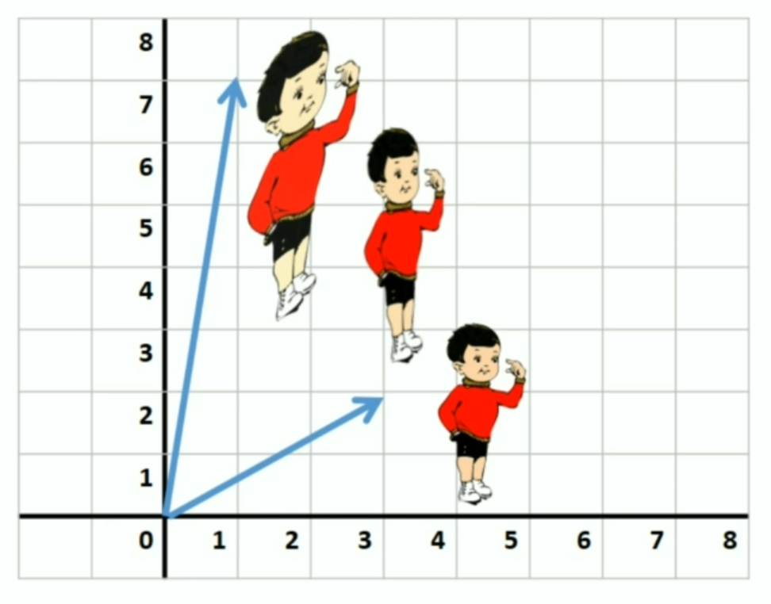
Vector Transformation Applications
Computer Graphics
Used a lot in computer graphics and video games to process moving objects in 3D space.

Slide 48
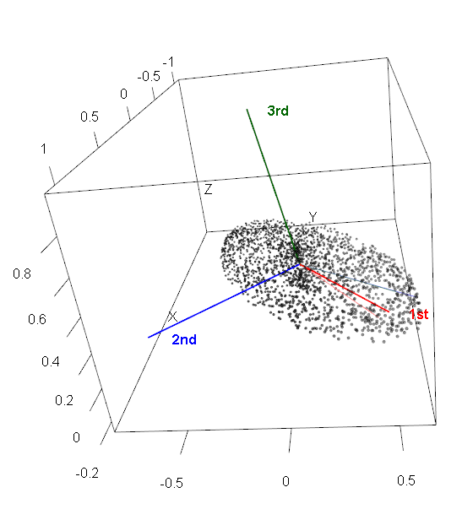
Vector Transformation Applications
Dimensions Reduction
Used for dimension reduction techniques like PCA.

Slide 49

Change of Basis

Slide 50
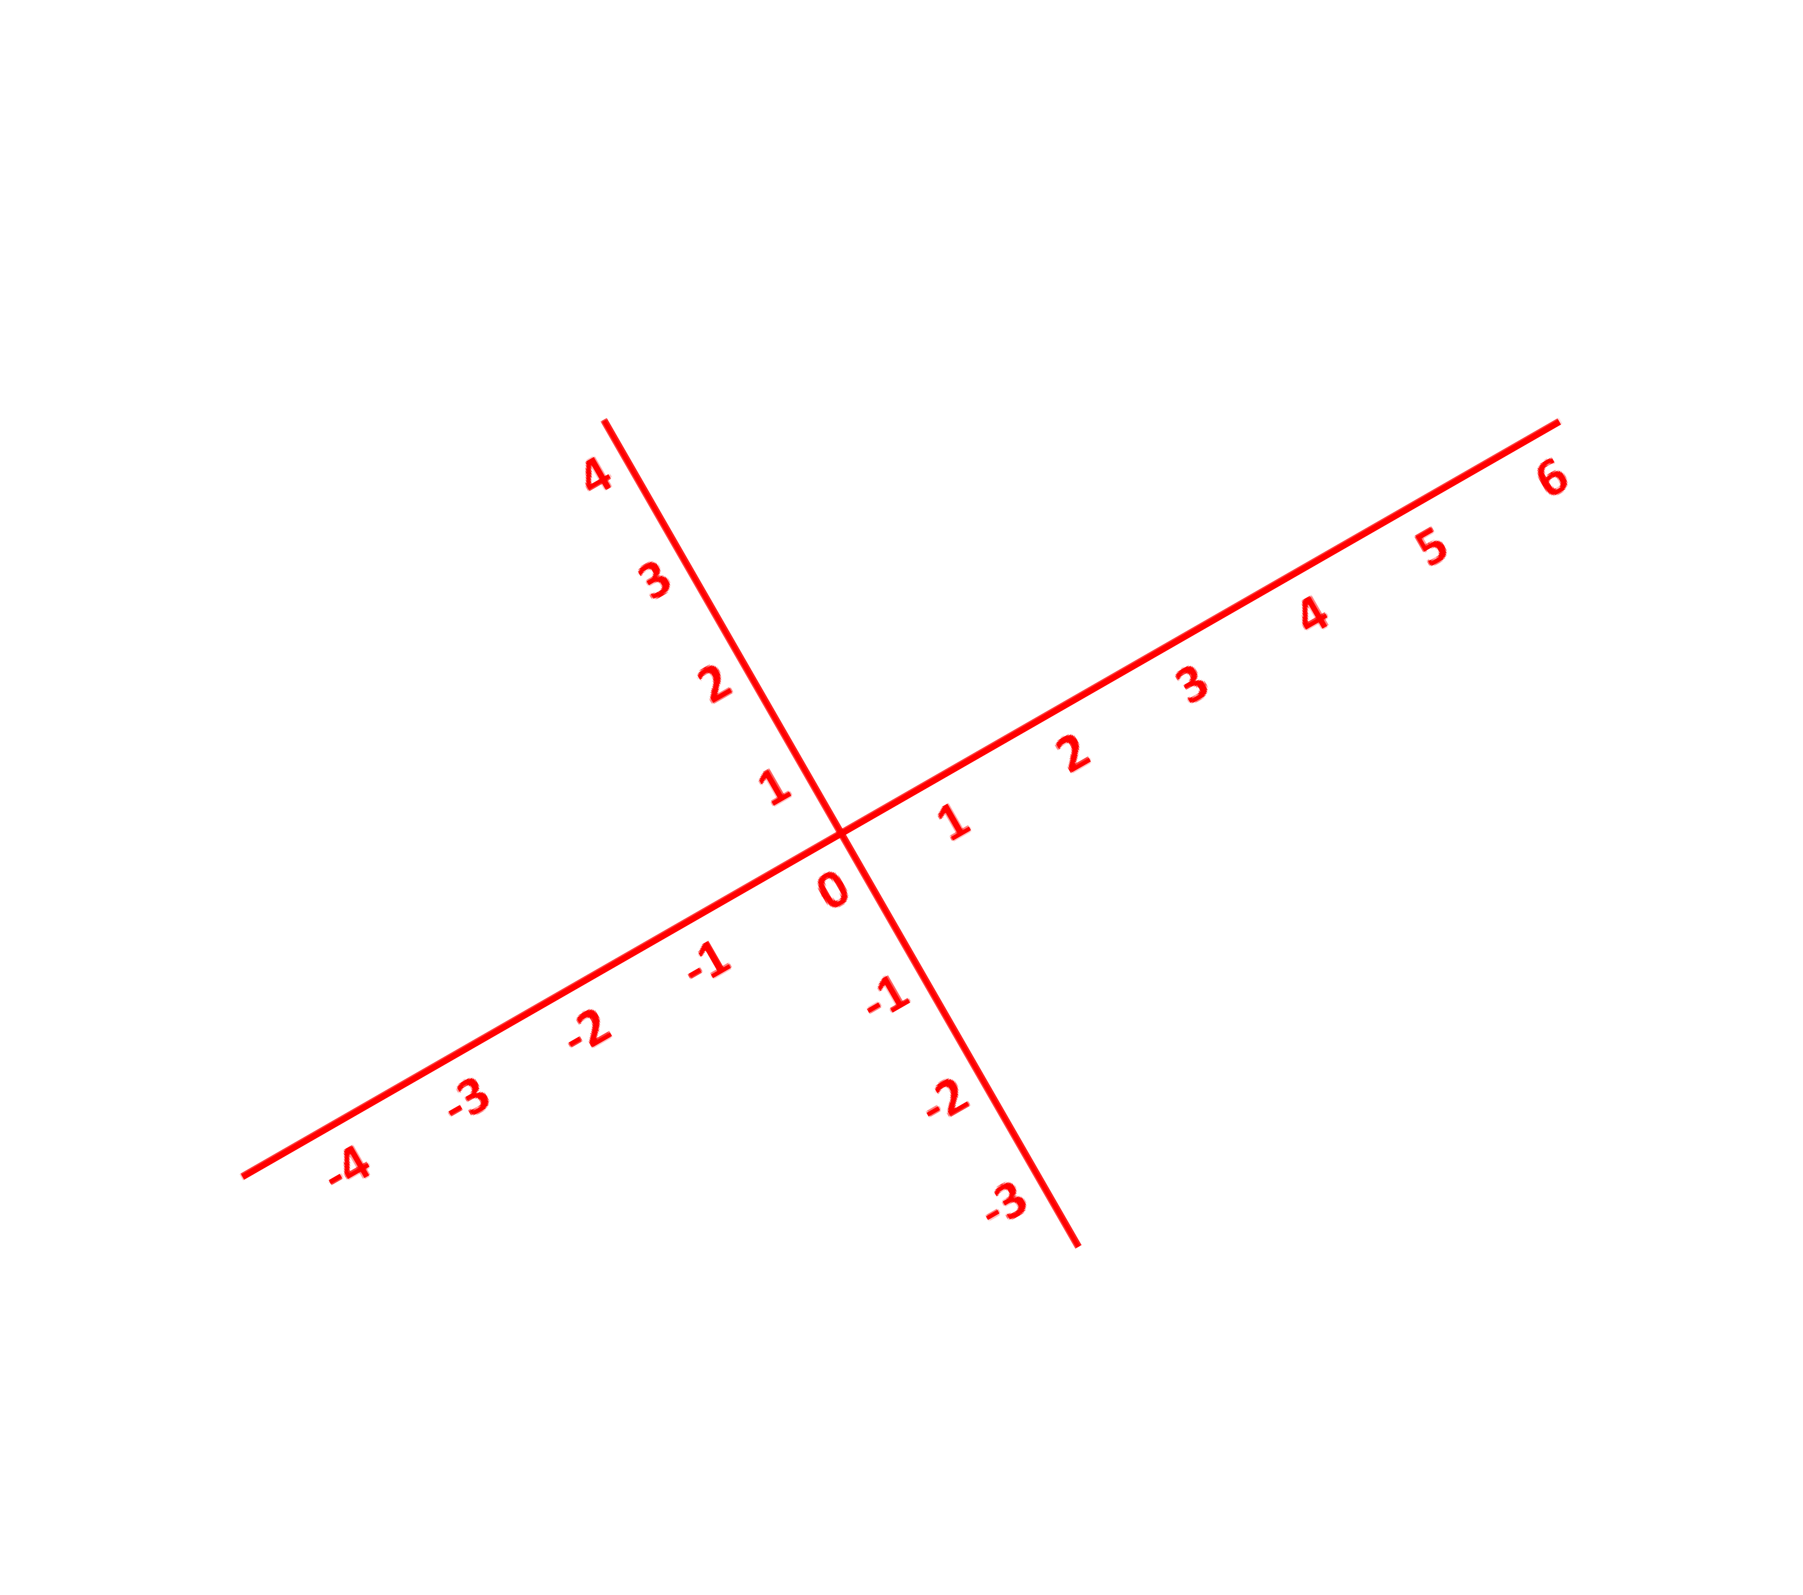
[ ]
Change of Basis – Alternate Coordinates
4
 |  |  |  | 4
 |  |  |  | 3
 |  |  |  | 2
 |  |  |  | 1
 |  |  |  | 0 | 1 | 2 | 3 | 4 | 5
V =
3
[ ]
5
0
V =

Slide 51
Change of Basis – Alternate Coordinates
1
1
-1
1
 |  |  |  | 4
 |  |  |  | 3
 |  |  |  | 2 |  | b1
 |  |  |  | b2 ¹ | b | 1
 |  |  |  | 0 | 1 | 2 | 3 | 4 | 5
V = 2 ¹ + 1 ⁻¹ = ²⁻¹ ¹ ¹ 2+1
b1 =
b2 =
W =
2
1
=
2b1 + b2
1
3
=

Slide 52
Change of Basis – Alternate Coordinates
1
1
-1
1
 |  |  |  | 4
 |  |  |  | 3
 |  |  |  | 2 |  | b1
 |  |  |  | b2 ¹ | b | 1
 |  |  |  | 0 | 1 | 2 | 3 | 4 | 5
V = 2 ¹ + 1 ⁻¹ = ²⁻¹ ¹ ¹ 2+1
b1 =
b2 =
W =
2
1
=
2b1 + b2
1
3
1 -1
1 1
2
1
=
=

Slide 53
Change of Basis – Alternate Coordinates
1
1
-1
1
 |  |  |  | 4
 |  |  |  | 3
 |  |  |  | 2 |  | b1
 |  |  |  | b2 ¹ | b | 1
 |  |  |  | 0 | 1 | 2 | 3 | 4 | 5
V
b1 =
b2 =
W =
2
1
=
2b1 + b2
1
3
1 -1
1 1
2
1
=
=

Slide 54
Change of Basis – Alternate Coordinates
1
1
-1
1
 |  |  |  | 4
 |  |  |  | 3
 |  |  |  | 2
 |  |  |  | 1
 |  |  |  | 0 | 1 | 2 | 3 | 4 | 5
_{V =} 1 -1 1 1
b1 =
b2 =
W =
2
1
=
2b1 + b2
.W
Matrix Transformation of W

Slide 55
Change of Basis – Alternate Coordinates
1
1
-1
1
 |  |  |  | 4
 |  |  |  | 3
 |  |  |  | 2
 |  |  |  | 1
 |  |  |  | 0 | 1 | 2 | 3 | 4 | 5
-1 _{W =} 1 -1 1 1
b1 =
b2 =
W =
2
1
=
2b1 + b2
.V

Slide 56
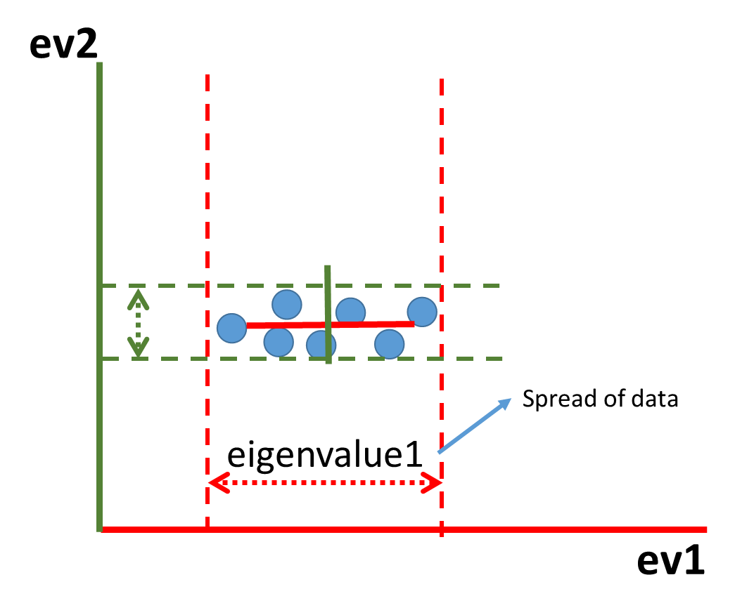
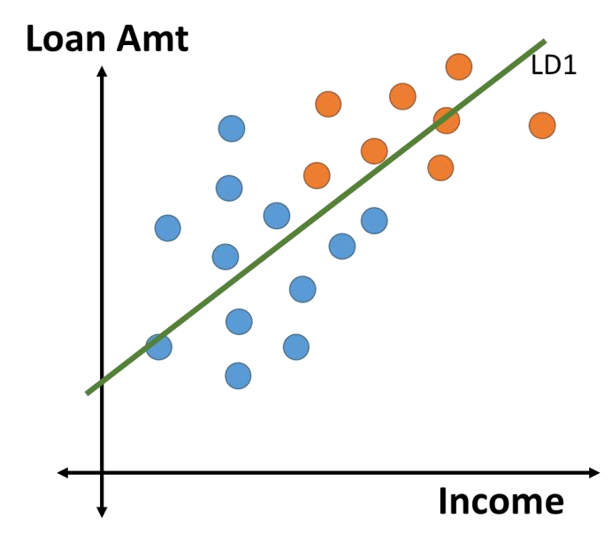
Why we are learning this?
Linear Discriminant Analysis
Principal Component Analysis

Slide 57

Eigenvectors and Eigenvalues

Slide 58
Eigenvector and Eigenvalues?
A non-zero vector that changes by a scalar during linear transformation.
Scalar value by which it changes its magnitude is eigenvalue
Note: Only thing that’s changing is our perception of the coordinates.

Slide 59
What is an Eigenvector and Eigenvalues?
A non-zero vector that changes by a scalar during linear
transformation
T.V = λ.V
 | 8
 | 7
 | 6
 | 5
 | 4
 | 3 |  |  |  | V
 | 2
 | 1
 | 0 | 1 | 2 | 3 | 4 | 5 | 6 | 7 | 8
T . V

Slide 60
2 1 2
0 3 0
4
0
2
4
2
=
0
0

Slide 61
6
2 1 2
5
4
0 3 2
2
3
2
2
1
-7 -6 -5 -4 -3 -2 -1
0
1
2
3
4
5
6
7
2
6
-1
3
=
-2
-3
2
6
-4
-5

Slide 62
T.V = λ.V
 |  |  |  |  |  |  | 6
 |  |  |  |  |  |  | 5
 |  |  |  |  |  |  | 4
 |  |  |  |  |  |  | 3 |  |  |  |  |  |  | λ = | 3
 |  |  |  |  |  |  | 2
 |  |  |  |  |  |  | 1 |  |  |  |  |  | λ | = 2
-7 | -6 | -5 | -4 | -3 | -2 | -1 | 0 | 1 | 2 | 3 |  |  | 4 | 5 |  | 6 | 7
 |  |  |  |  |  |  | -1
 |  |  |  |  |  |  | -2
 |  |  |  |  |  |  | -3
 |  |  |  |  |  |  | -4
 |  |  |  |  |  |  | -5

Slide 63
Thank You!

